Slide 1

University of Central Florida COP 3330 Object Oriented Programming

Slide 2
Graphical User Interface

Slide 3

JButton
A clickable button
button can display both text and an image
each button has its text in a different place relative to its image
the underlined letter in each button's text shows the mnemonic, allows for pressing the Alt key and the mnemonic

Slide 4
JButton
A clickable button
implement event handling depends on the type of button
Normally implement an action listener which is notified every time the user clicks the button

Slide 5
Write an Action Listener
Action listeners are event handlers
Implement an action listener to define what should be done when an user performs certain operation
An action event occurs (i.e. an action is performed by the user)
user clicks a button
chooses a menu item
presses Enter in a text field
The result is that an actionPerformed message is sent to all action listeners that are registered on the relevant component

Slide 6
Write an Action Listener
To write an Action Listener, follow these steps
Declare an event handler class and specify that the class either implements an ActionListener interface or extends a class that implements an ActionListener interface
public class MyClass implements ActionListener {
Register an instance of the event handler class as a listener on one or more components
someComponent.addActionListener(instanceOfMyClass);
Include code that implements the methods in listener interface.
public void actionPerformed(ActionEvent e) { ...//code that reacts to the action... }

Slide 7
Write an Action Listener
To detect when the user clicks an onscreen button (or does the keyboard equivalent), a program must have an object that implements the ActionListener interface
The program must register this object as an action listener on the button (the event source), using the addActionListener method
When the user clicks the onscreen button, the button fires an action event
This results in the invocation of the action listener's actionPerformed method (the only method in the ActionListener interface).
The single argument to the method is an ActionEvent object that gives information about the event and its source

Slide 8
Action Listener Interface
Method | Purpose
actionPerformed(actionEvent) | Called just after the user performs an action

Slide 9
Action Event Class
Method | Purpose
String getActionCommand() | Returns the string associated with this action. Most objects that can fire action events support a method called setActionCommand that lets you set this string.
int getModifiers() | Returns an integer representing the modifier keys the user was pressing when the action event occurred. You can use the ActionEvent-defined constants SHIFT_MASK, CTRL_MASK, META_MASK, and ALT_MASK to determine which keys were pressed. For example, if the user Shift-selects a menu item, then the following expression is nonzero: actionEvent.getModifiers() & ActionEvent.SHIFT_MASK
Object getSource() (in java.util.EventObject) | Returns the object that fired the event.

Slide 10
Menus
A menu provides a space-saving way to let the user choose one of several options.
Menus are unique in that they aren't placed with the other components in the UI
A menu usually appears either in a menu bar or as a popup menu
A menu bar contains one or more menus and has a customary, platform-dependent location, along the top of a window
A popup menu is invisible until the user makes a platform-specific mouse action (i.e. pressing the right mouse button), the popup menu then appears under the cursor.

Slide 11
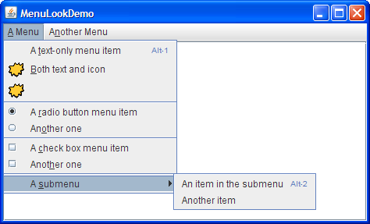
Menus

Slide 12
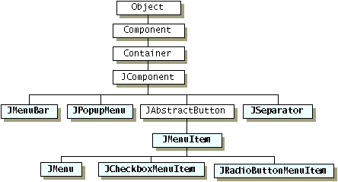
Menus

